Slide 1
Content and Structure Based Clustering of XML Documents
Committee - Dr. Ying Zhu
- Dr.Xiaolin Hu
Venkata Sarath Kumar Galimelu

Slide 2
OBJECTIVE
To develop an efficient technique for clustering of XML documents on the basis of their degree of structure similarities and content similarities.
MOTIVATION
Most of the existing XML Document Clustering algorithms developed are either Content based or Structure based. In many practical cases, these approaches results in erroneous clusters. A clustering technique exploiting the similarities on the basis of both features would give better and accurate results.

Slide 3
TOOLS AND TECHNOLOGIES USED
XML DOM Parser: A platform and language neutral interface that allows programs to dynamically access and update the content, structure, and style of a XML document.
MATLAB
Eclipse IDE using Java Development Kit
CodeBlocks C++ Editor

Slide 4
PROPOSED APPROACH
Similarities of XML Documents on the basis of their structure and their content are calculated separately.
Both the similarities evaluated from the two approaches are combined to evaluate the final similarity.
On the combined similarity, a clustering algorithm is applied to cluster the documents into different groups.

Slide 5
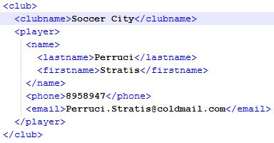
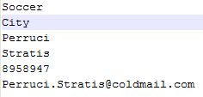
CONTENT BASED
Content of each XML document is fetched and stored in a separate text file.
Figure 1 : Text file representation of a XML Document

Slide 6
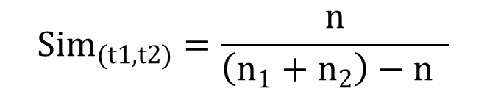
Compare all the terms of each text file with every other file to find the number of common terms.
Document Content Similarity Value (DCSV) calculated for each pair using the formula
Here,
n₁ and n₂ are the total no. of terms in text files t₁ and t₂ respectively and
n is the no. of common terms in both files.
Similarity value is stored in Document Content Similarity Matrix.

Slide 7
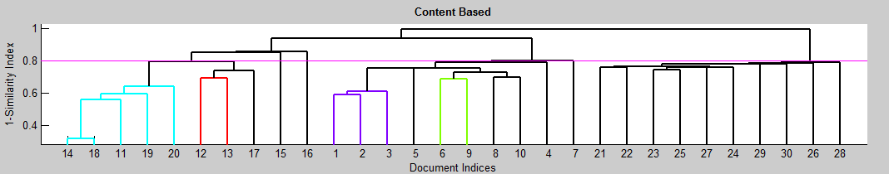
a.xml
b.xml
c.xml
a.c.xml.txt
b.c.xml.txt
c.c.xml.txt
 | a | b | c
a
b
c
XML Doc.
Text
File
Document
Content Similarity Matrix
Figure 2: Evaluate Document Content Similarity Value
Figure 3: Cluster formation based on content similarities only

Slide 8
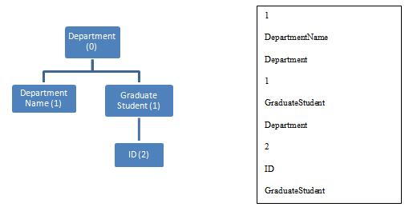
STRUCTURE BASED
Structure information of each XML document is stored in Level-Node-Parent (LNP) format in separate text file.
Figure 4: LNP representation of XML Document.
For a particular text ﬁle, compare the N-P links present at a particular level with that of other ﬁles at corresponding level and ﬁnd the total number of common and distinct N-P links at each level.

Slide 9
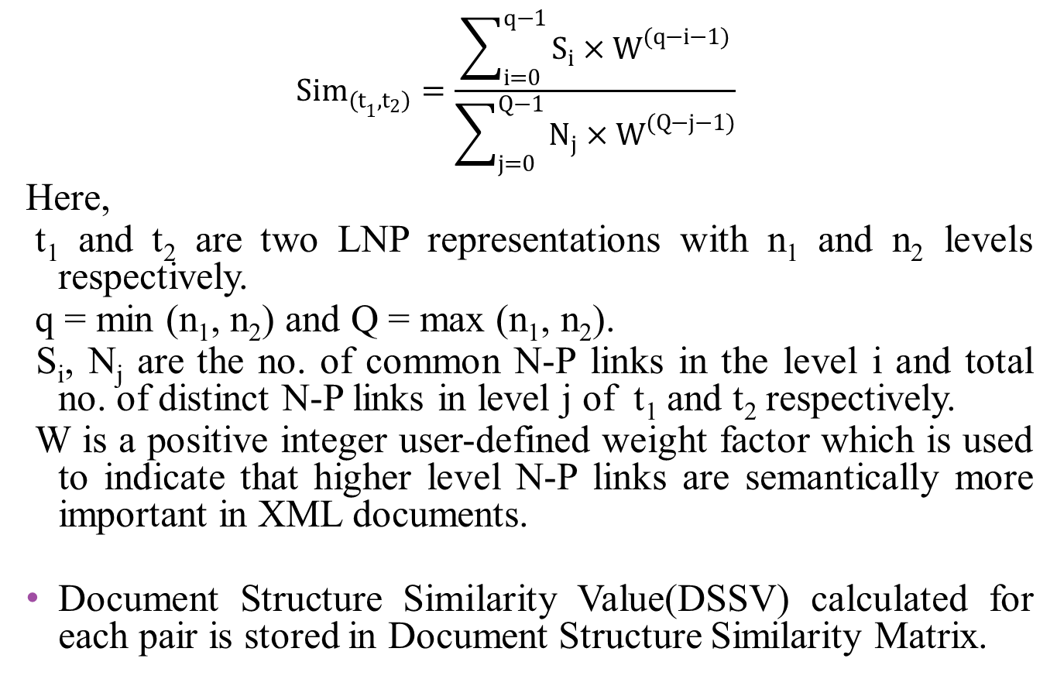

Slide 10
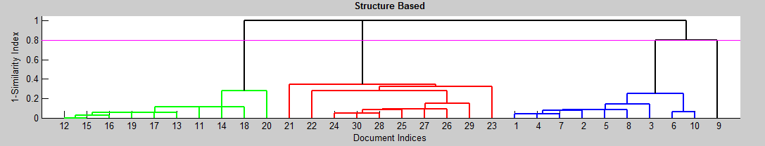
a.xml
b.xml
c.xml
a.s.xml.txt
b.s.xml.txt
c.s.xml.txt
 | a | b | c
a
b
c
LNP
Format
File
XML Doc.
Document
Structure Similarity Matrix
Figure 5: Evaluate Document Structural Similarity Value
Figure 6: Cluster formation based on structure similarities only

Slide 11
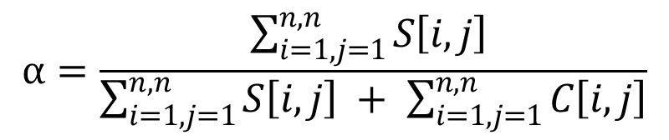
COMBINED APPROACH
Combine the similarity value evaluated from the content and the structure based approach to find the combined Document Similarity Value (DSV).
DSV= α*DSSV+(1- α)*DCSV
Here α is coefficient of data significance and is given by
Here,
S(i,j) = DSSV between i^{th} and j^{th} XML documents
C(i,j) = DCSV between i^{th} and j^{th} XML documents and
n = total number of XML documents.
Values are stored in Document Similarity Matrix.

Slide 12
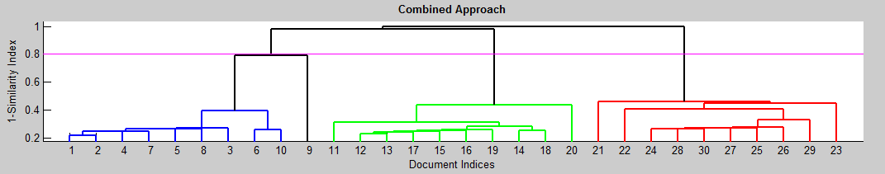
Content Similarity Matrix
Cluster1
Cluster 2
Document Similarity Matrix
Clustering Algorithm
Cluster 3
Structure Similarity Matrix
Cluster 4
Figure 7: Clustering on the combined similarity value
Figure 8: Cluster formation by combining content and structure similarities

Slide 13

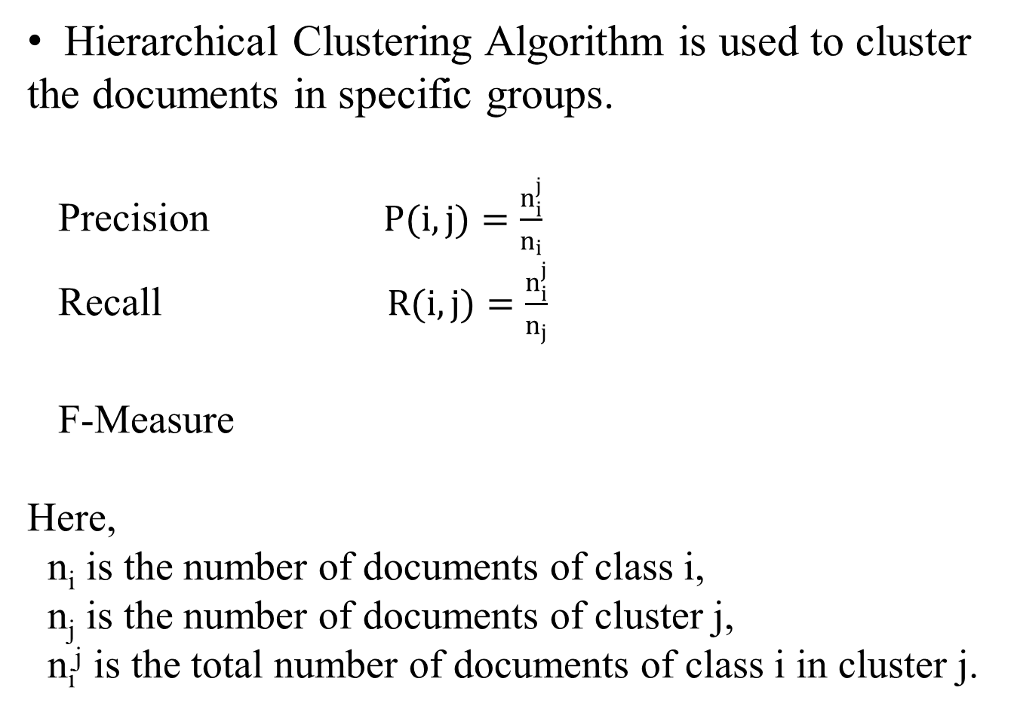
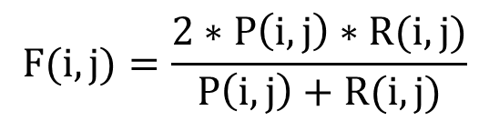

Slide 14
Precision is defined as the rate of correct matches in the generated solution
Recall is defined as the rate of correct macthes

Slide 15
RESULTS AND CONCLUSIONS
Clusters | No. of Docs | Recall | Precision | F-measure
Actors | 10 | 9/10=0.9 | 9/9=1 | 0.947
Bib | 10 | 8/10=0.8 | 8/8=1 | 0.889
Club | 10 | 10/10=1 | 10/10=1 | 1
Table 1: Result of Clustering on the basis of Document Content Similarity Values (DCSV)
Clusters | No. of Docs | Recall | Precision | F-measure
Actors | 10 | 9/10=0.9 | 9/9=1 | 0.947
Bib | 10 | 10/10=1 | 10/10=1 | 1
Club | 10 | 10/10=1 | 10/10=1 | 1
Table 2: Result of Clustering on the basis of Document Structure Similarity Values (DSSV)
Clusters | No. of Docs | Recall | Precision | F-measure
Actors | 10 | 1 | 1 | 1
Bib | 10 | 1 | 1 | 1
Club | 10 | 1 | 1 | 1
Table 3: Clustering on the basis of Document Similarity Value (DSV)

Slide 16
The Combined approach shows higher Precision, Recall and F-Measure values when compared with the results of clustering based on only structure or only content.
Determining the value of α from the similarity matrices gives true weightage to the content and structure nature of the dataset.
This approach can thus be used to efficiently and accurately cluster the XML Documents.

Slide 17
REFERENCES
[1] Bray, T., Paoli, J., Sperberg-McQueen, C., Maler, E. & Yergeau, F. (2004), `eXtensible Markup Language (XML) 1.0 (third edition) w3c recommendation'.
[2] Han, J. & Kamber, M. Data Mining: Concepts and Techniques, San Diego, USA: Morgan Kaufman Publisher, 2001.
[3] Lee, L. M., Yang, L. H., Hsu, W. & Yang, X. (2002), Xclust: Clustering xml schemas for effective integration, in `11th ACM International Conference on Information and Knowledge Management (CIKM'02)', Virginia.
[4] Salton, G. & McGill, M. J. (1983), `Introduction to modern information retrieval', McGraw-Hill.
[5] Shen, Y. & Wang, B. (2003), Clustering schema less XML document, in `11th international conference on Cooperative Information System'.

Slide 18
[6] Nayak, R. and Xu, S. XCLS: A Fast and Effective Clustering Algorithm for Heterogeneous XML Documents. In Proceedings of the Pacific-Asia Conference on Knowledge Discovery and Data Mining (PAKDD’06) (The Singapore, April 9-12, 2006). 2006, pp. 292-302.
[7] Yongming G, Dehua, C. & JIajin, L., An Extended Vector Space Model for XML Information Retrieval. IEEE Second International Workshop on Knowledge Discovery and Data Mining (Moscow, 2009).
[8] Kutty S., Nayak R., Li Y., XML Documents Clustering using Tensor space Model- A preliminary Study. IEEE International Conference on Data Mining Workshops (Sydney, 2010).
[9] L. Denoyer and P. Gallinari, “Report on the XML mining track at INEX 2005 and INEX 2006: categorization and clustering of XML documents,” SIGIR Forum, vol. 41, no. 1, pp. 79–90, 2007.
[10] Datasets: http://www.cs.wisc.edu/niagara/data.html.

Slide 19
[11] Kutty, S., Nayak, R., Li, Y. (2009). “XCFS – An XML Documents Clustering Approach using both the Structure and the Content”. Conference on Information and Knowledge Management (CIKM’09), Hong Kong, China, pp 1729-1732.
[12] Kutty, S., Nayak R., and Li, Y., (2010). Utilising semantic tags in XML clustering, in Focused Retrieval and Evaluation, S. Geva, J. Kamps, and A. Trotman, Editors. Springer Berlin/ Heidelberg. pp. 416-425.
[13] Tran, T., Nayak, R., Bruza, P., (2008). “Combining Structure and Content similarities for XML document Clustering”, The Australasian Data Mining Conference: AusDM 2008, vol. 87, Adelaide, Australia, Nov 2008.
[14] Nayak, R., De Vries, C., Kutty, S., Geva, S., Denoyer, L., & Gallinari, P., (2010). Overview of the INEX 2009 XML Mining Track: Clustering and Classification of XML Documents.In S. Geva, J. Kamps & A. Trotman (Eds.),2010, Focused Retrieval and Evaluation (Vol. 6203, pp. 366-378): Springer Berlin / Heidelberg.

Slide 20
[15] Yang, J., Cheung, W. & Chen, X. (2005), Learning the kernel matrix for xml document clustering, in `e-Technology, e-Commerce and e-Service'.

Slide 21
Thank you

